Slide 1
GLSL Shader Language
Hosein Ghahremanzadeh
Notes:
The background is a sample of volumetric lighting in my own 3D graphics engine, HG3D

Slide 2

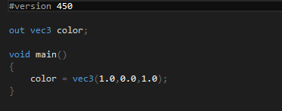
GLSL Version
Each version of OpenGL has a corresponding GLSL language version.
The first line at each shader defines the language version.
We use OpenGL 4.5 with GLSL version 450. (330 for OpenGL 3.3)
GLSL is a C-like language.

Slide 3
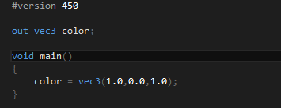
Main Function
The entry point of a shader is the main function.
Main function does not return any values hence the return type is void.
Main function does not have any input parameter’s either.

Slide 4

Variable Types Scaler Types
$bool$: conditional type. Can only hold $true$ or $false$.
$int$: signed 32-bit, 2’s compliment integer.
$uint$: unsigned 32-bit integer.
$float$: IEEE-754 single-precision floating-point.
$double$: IEEE-754 double-precision floating-point.

Slide 5

Variable Types Vector Types
$bvec$: vector of booleans.
$ivec$: vector of integer.
$uvec$: vector of unsigned integers.
$vec$: vector of single-precision floating-points.
$dvec$: vector of double-precision floating-point.
Each of the above types have 2, 3, and 4 component types, e.g.:
$vec2$, $vec3$, and $vec4$

Slide 6

Variable Types Vector Types: Accessing Components
Component of vectors can be accessed by a method called Swizzling:
Calling first, second, third and forth $x$, $y$, $z$ and $w$ or $r$, $g$, $b$, and $a$ or $s$, $t$, $p$, and $q$ respectively.
You can create a vector by accessing any combination of each group up to 4 components.
On GLSL 4.2 and later scalers can be swizzled as well, of-course only the first component can be swizzled.

Slide 7
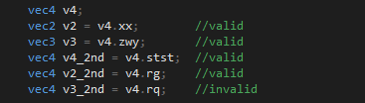
Variable Types Vector Types: Swizzling

Slide 8
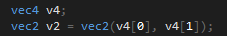

Variable Types Vector Types: Accessing Components
Component of vectors can be accessed by indexing as well. Indices $0$, $1$, $2$, and $3$ corresponding to first, second, third, and forth component.

Slide 9
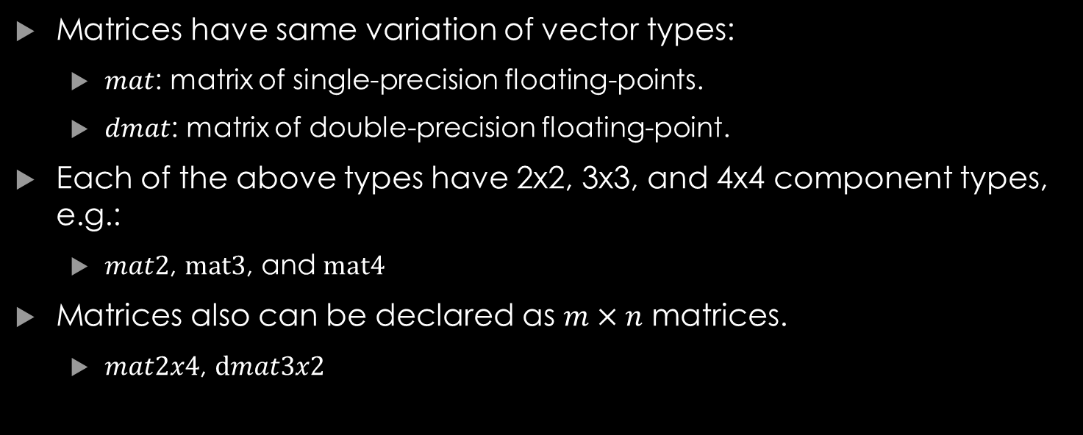
Variable Types Matrix Types
Matrices have same variation of vector types:
$mat$: matrix of single-precision floating-points.
$dmat$: matrix of double-precision floating-point.
Each of the above types have 2x2, 3x3, and 4x4 component types, e.g.:
$mat2$, $mat3$, and $mat4$
Matrices also can be declared as $m×n$ matrices.
$mat2x4$, $dmat3x2$
Notes:
Matrices are only of floating point types, single precision and double precision types.

Slide 10
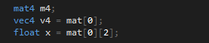
Variable Types Matrix Types: Accessing Components
Components of matrices are accessed by a pair of indices.
Each column is access by an index, as a vector.

Slide 11

Variable Types Arrays
Arrays of each basic type is available.
Arrays cannot be multidimensional unless on OpenGL 4.3 or above.
Length of an array must be constant, and specified at deceleration.
The length of an array is available by $.length()$ function.
Notes:
In some cases it is not necessary to specify array size on decelaration, which is not in the scope of this course.

Slide 12
Shader Outputs and Inputs
Global variables are used for input and output.
Shaders have built-in output and input variable.
User defined input and output variables are declared in inside the shader as global variables.
The input to each shader is from the previous shader output, except for vertex shader.
The output of fragment shader is also passed to program rather than the next shader stage (since it is the last shader stage).
Notes:
Since shader’s main function does not return any value, or does not accept any input parameters, global variables are used for getting input and passing output.
Since there are no shader stages before the vertex shader the input for a shader stage is defined in by the program.

Slide 13
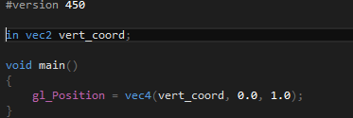
Shader Outputs and Inputs
Output global variables are declared by out keyword.
Input global variables are declared by in keyword.
Vertex shader needs at least one user defined input variable.
Notes:
Vertex shader does not have any built-in input variable for vertex data.

Slide 14
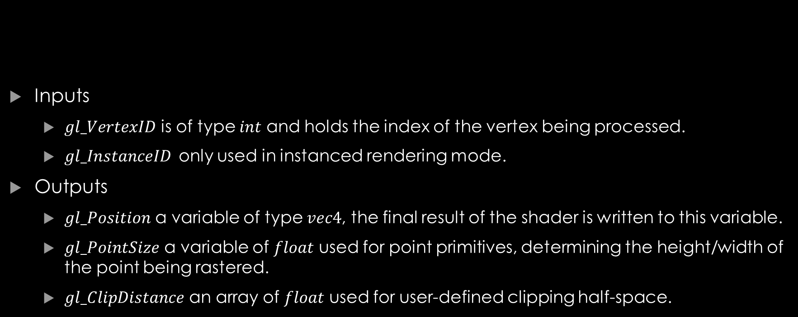
Built-in Input and Output Variables Vertex Shader
Inputs
$gl_VertexID$ is of type $int$ and holds the index of the vertex being processed.
$gl_InstanceID$ only used in instanced rendering mode.
Outputs
$gl_Position$ a variable of type $vec4$, the final result of the shader is written to this variable.
$gl_PointSize$ a variable of $float$ used for point primitives, determining the height/width of the point being rastered.
$gl_ClipDistance$ an array of $float$ used for user-defined clipping half-space.
Notes:
$gl_VertexID$ if it’s not the indexed rendering mode, this holds the effective index of the vertex being rendered.
Instanced rendering mode is a way to reduce draw calls, this is not in the scope of this course.
The value written into $gl_Position$ is used as the final position of the vertex (unless it is modified by geometry shader) which propagated through the pipeline stages and will appear as $gl_FragCoord$ in fragment shader.
User-defined clipping half-spaces are used for clipping the scene, we will not discuss this.

Slide 15
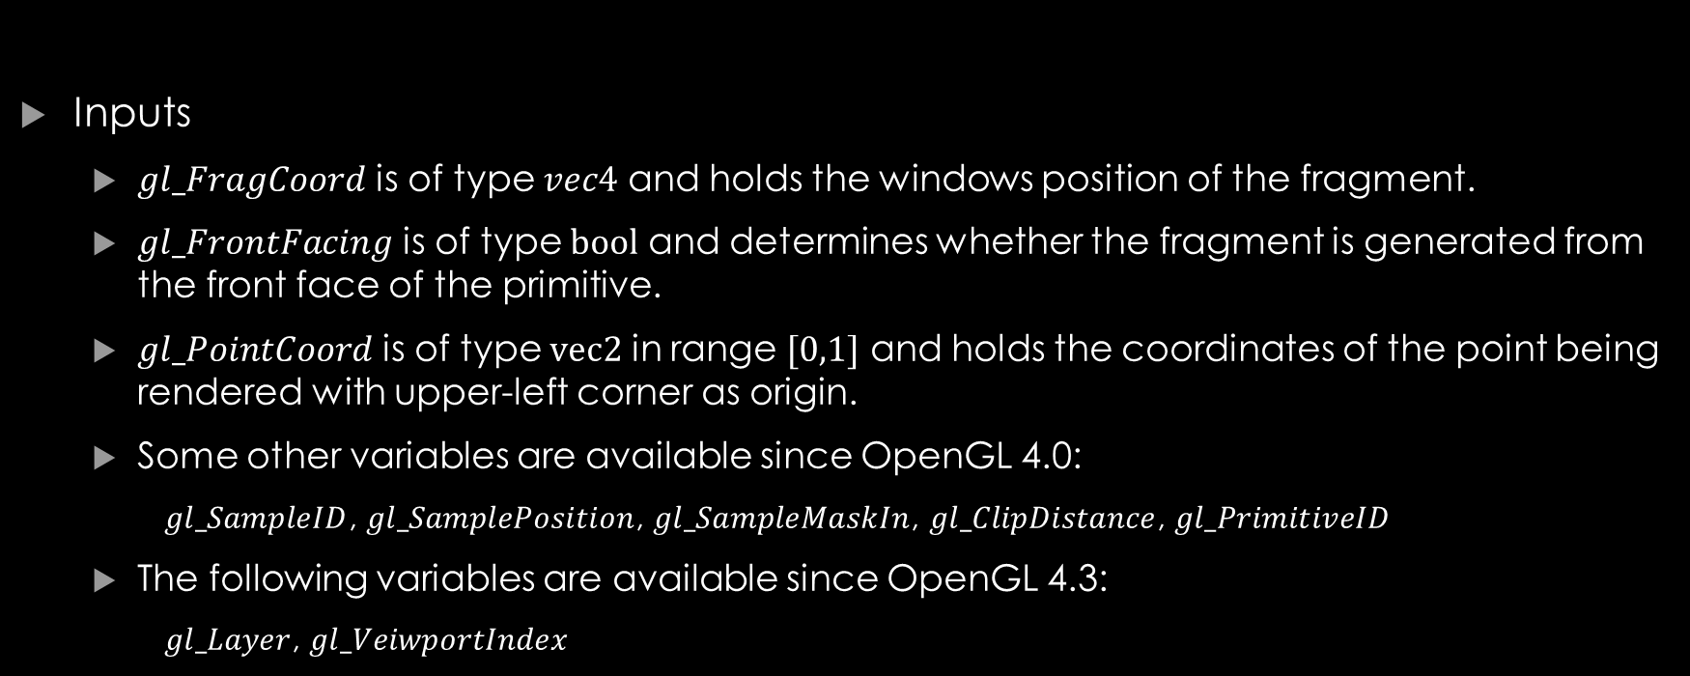
Built-in Input and Output Variables Fragment Shader
Inputs
$gl_FragCoord$ is of type $vec4$ and holds the windows position of the fragment.
$gl_FrontFacing$ is of type $bool$ and determines whether the fragment is generated from the front face of the primitive.
$gl_PointCoord$ is of type $vec2$ in range $[0,1]$ and holds the coordinates of the point being rendered with upper-left corner as origin.
Some other variables are available since OpenGL 4.0:
$gl_SampleID$, $gl_SamplePosition$, $gl_SampleMaskIn$, $gl_ClipDistance$, $gl_PrimitiveID$
The following variables are available since OpenGL 4.3:
$gl_Layer$, $gl_VeiwportIndex$
Notes:
$gl_FragCoord$ hold the window space coordinates of the fragment, its forth components is $\frac{1}{w_{clip}}$ where the $w_{clip}$ is the interpolated value of the $w$ component of $gl_Position$. The $z$ component of the $gl_FragCoord$ will be stored in depth buffer, unless $gl_FragDepth$ is modified.

Slide 16

Built-in Input and Output Variables Fragment Shader
Outputs
$gl_FragDepth$ is of type $float$ and will be written as depth to depth buffer.
$gl_SampleMask$ is used in multisampled rendering, and if not modified will be statically filled with $gl_SampleMaskIn$.

Slide 17
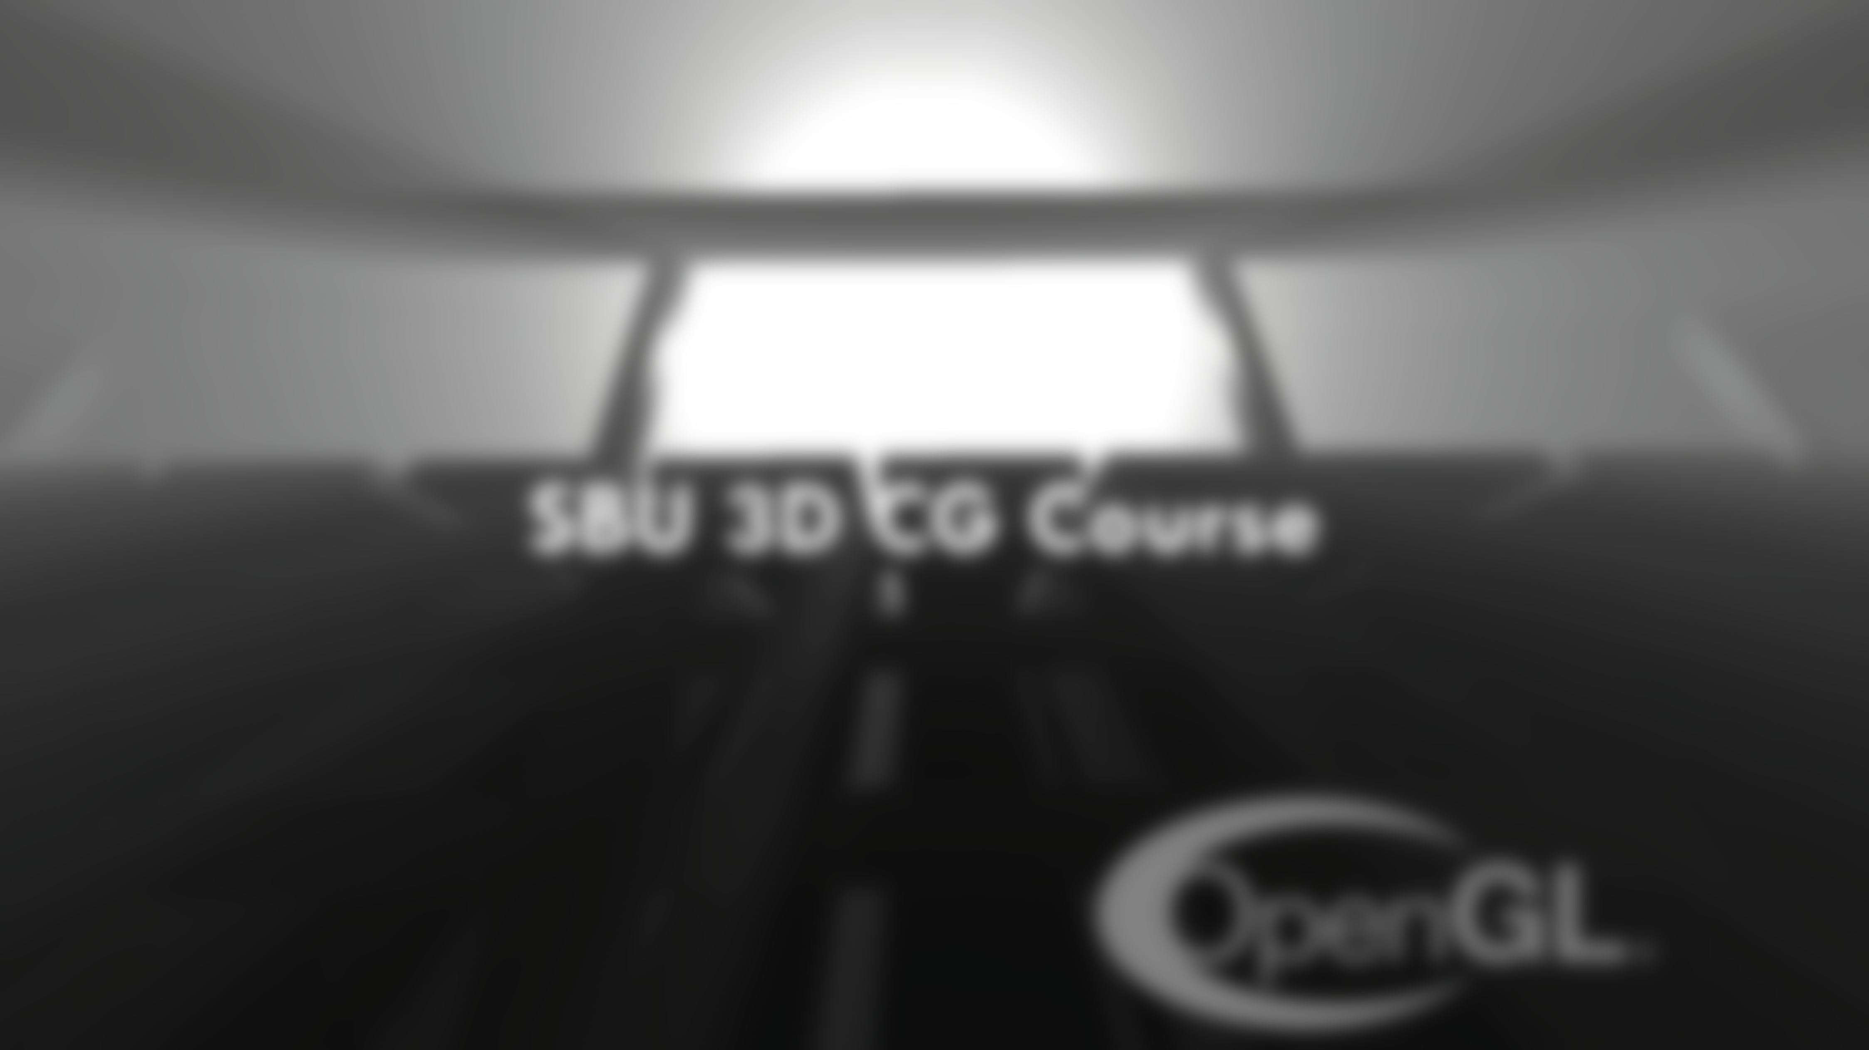
Your questions

Slide 18
Helpful links
https://www.khronos.org/opengl/wiki/Data_Type_(GLSL) (GLSL types)
https://www.khronos.org/opengl/wiki/Built-in_Variable_(GLSL) (GLSL built-in variables)
Notes:
https://www.khronos.org/opengl/wiki/Data_Type_(GLSL) (GLSL types)
https://www.khronos.org/opengl/wiki/Built-in_Variable_(GLSL) (GLSL built-in variables)

